Slide 1
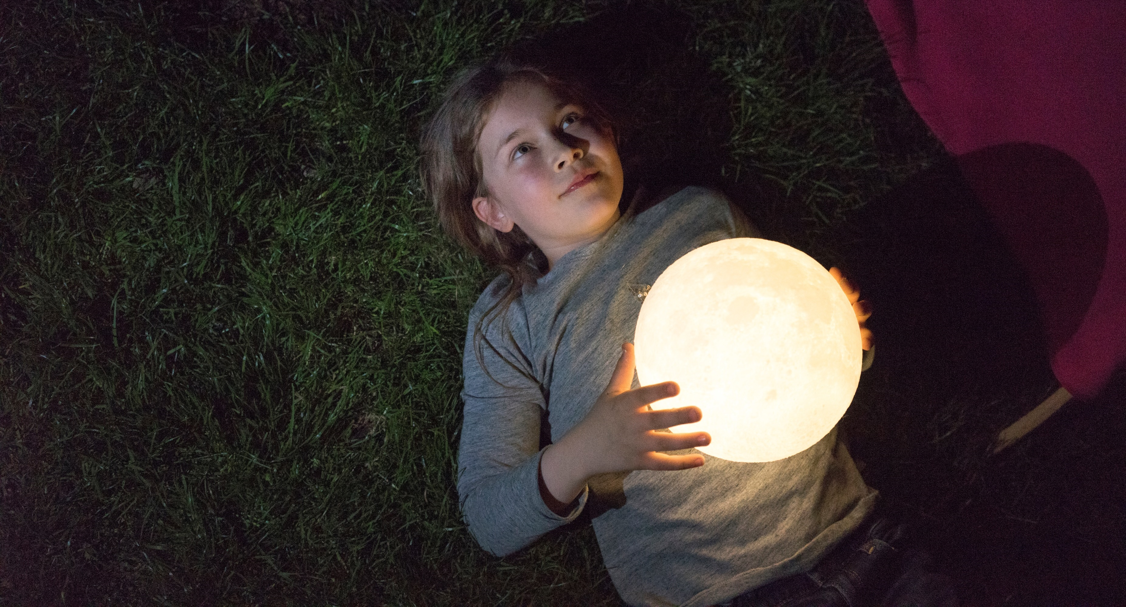
Introduction to NLP
Pyladies workshop| dr. Saskia E. Lensink | 25-11-20

Slide 2
Contents
Introduction to nlp
Introducing
Overview subfields nlp
Let’s get to work!

Slide 3
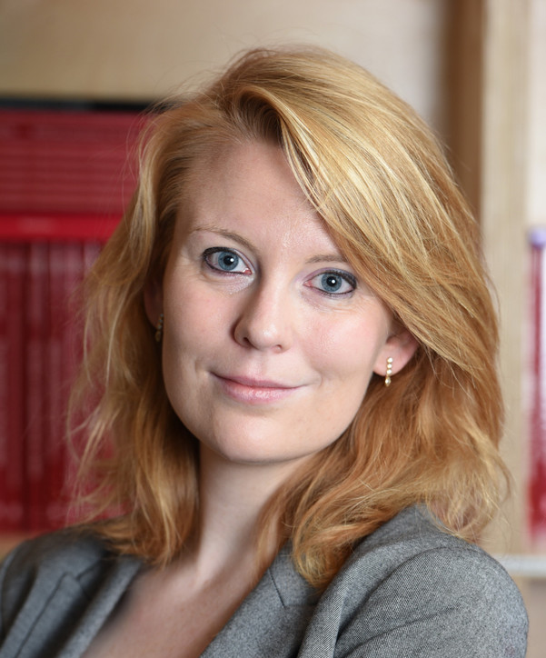
introducing
PhD degree from Leiden University in experimental & computational linguistics
Computational stylistics at Huygens Institute
Data scientist at an IT consultancy firm
Current: NLP research scientist at TNO
Fascinated by language since I was a little kid
Loves to talk, eat, cook, read, and dance
Saskia Lensink

Slide 4
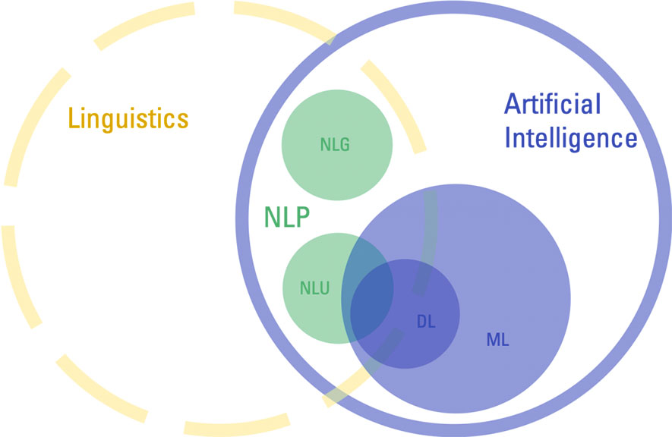

Slide 5
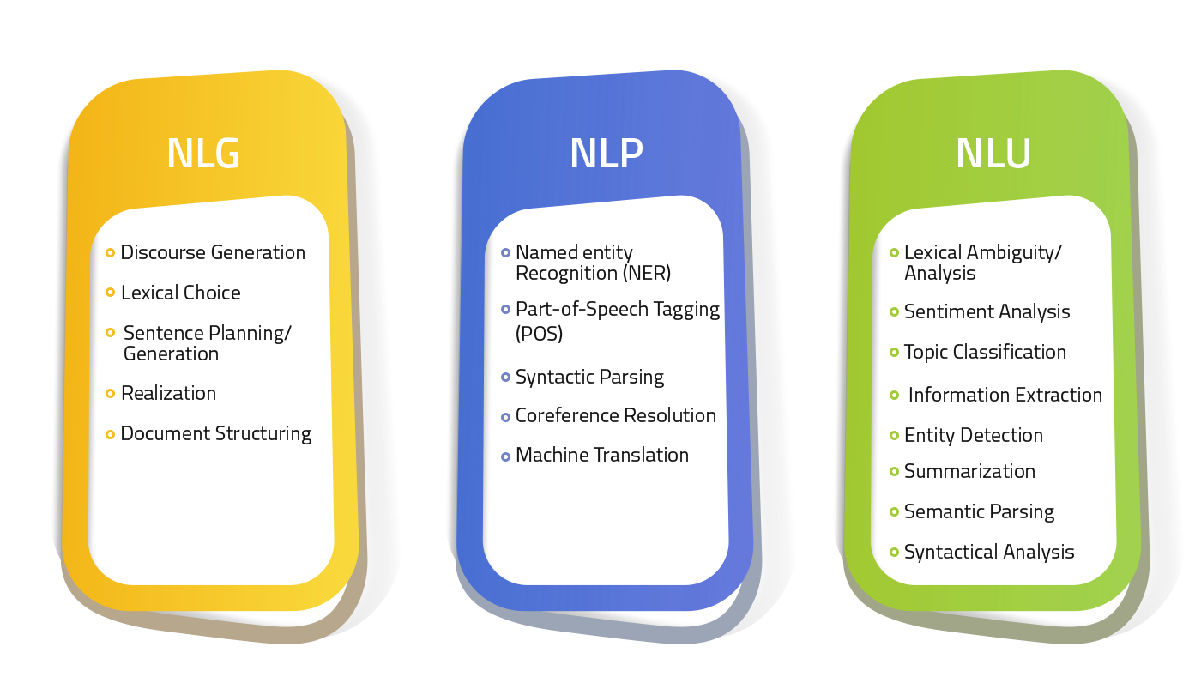
Nlp for text…
NLG: natural language generation
NLP: natural language processing
NLU: natural language understanding
https://iconflux.com/blog/differentiate-between-nlp-nlg-and-nlu

Slide 6
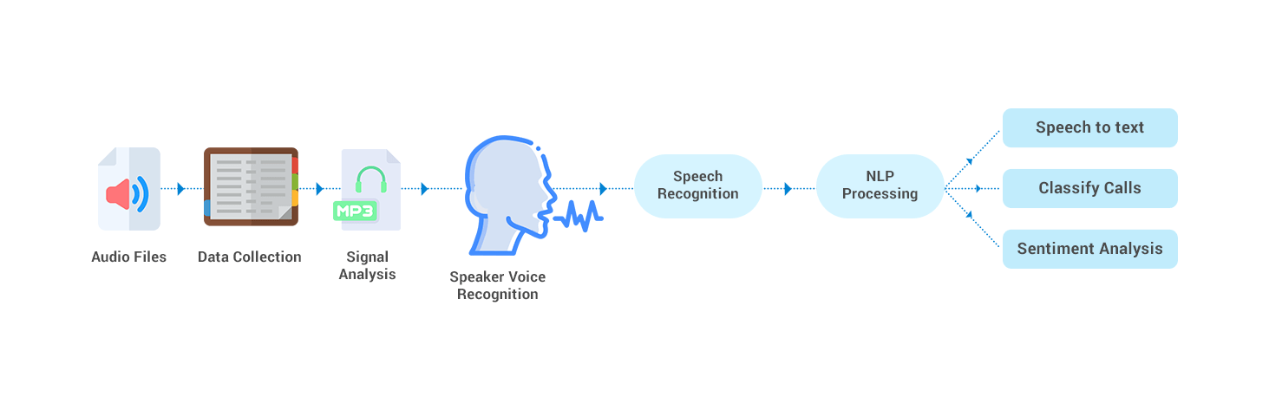
… and nlp for speech
Also known as ASR or Automatic Speech Recognition
https://www.osplabs.com/ai-speech-recognition/

Slide 7
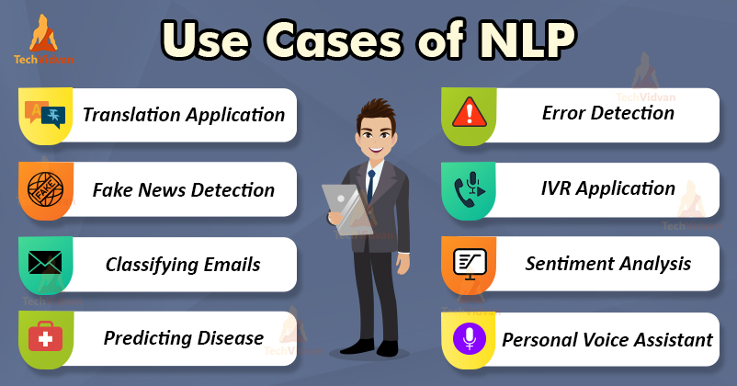

Slide 8
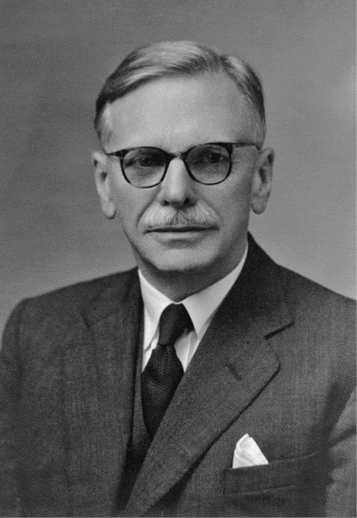
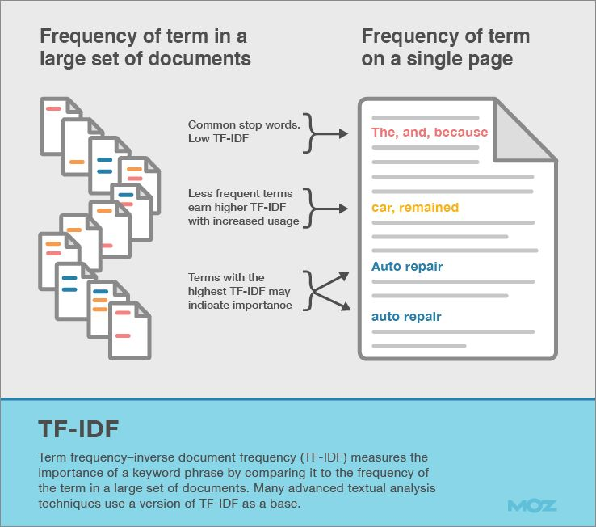
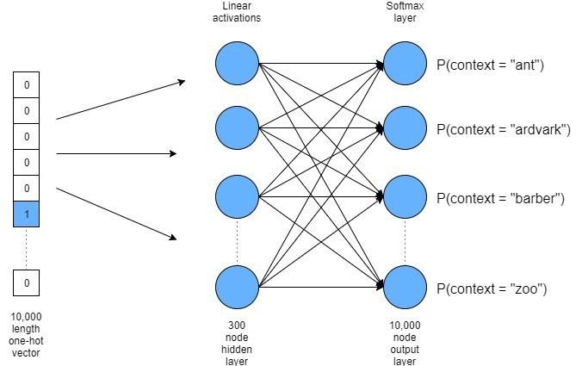
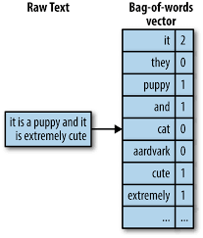
From text to digits
Bag of words
TF-IDF
Word embeddings

Slide 9
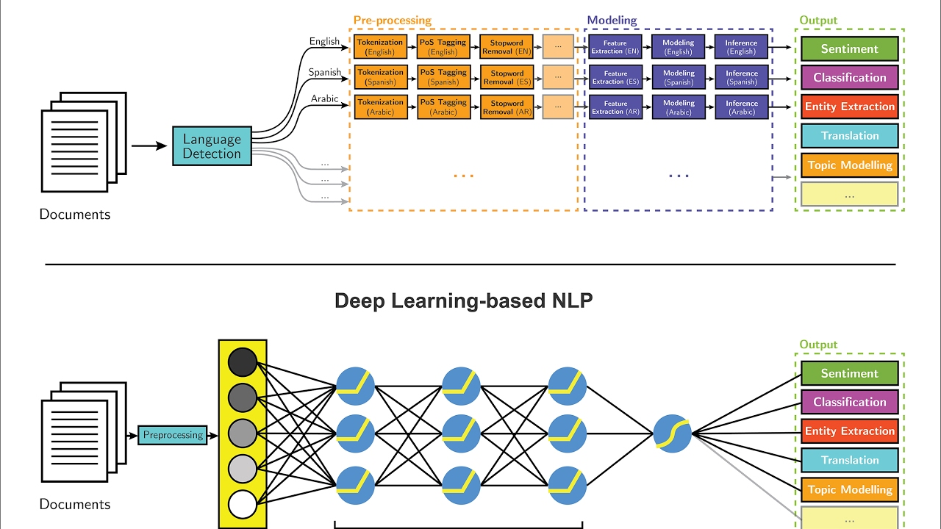
From traditional nlp to end-to-end architectures

Slide 10

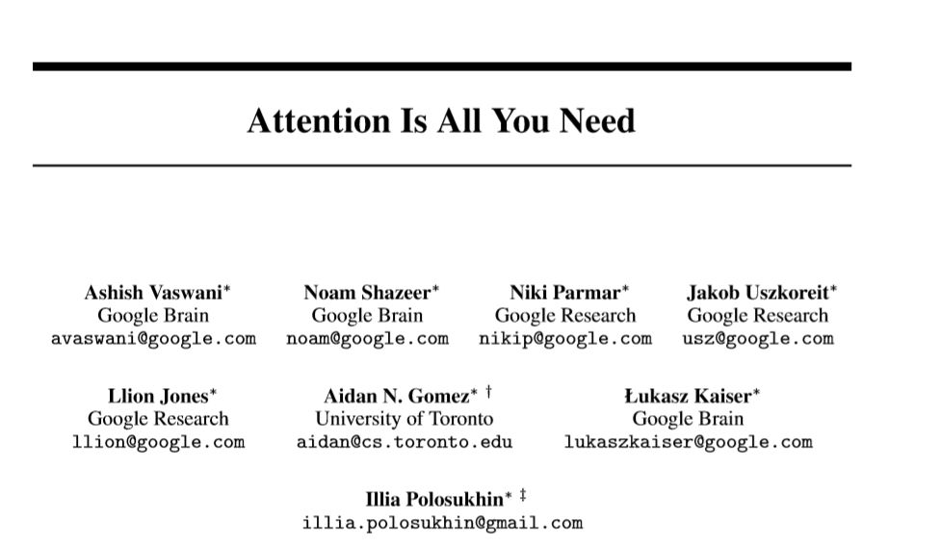
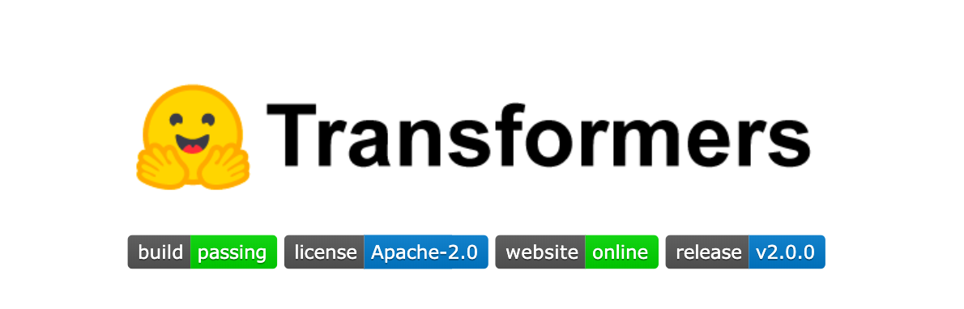
attention
Huggingface/Transformers
10
22/09/2020
NLP Primer

Slide 11
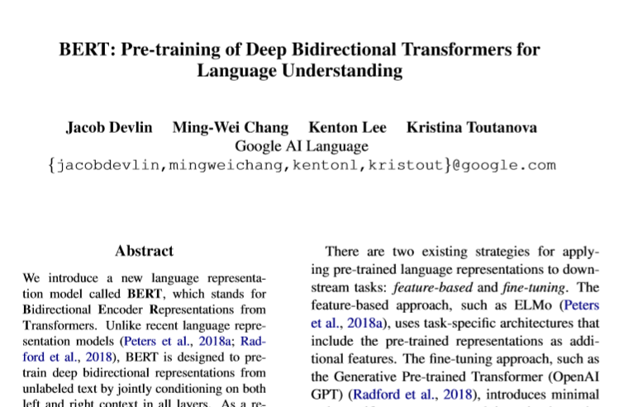
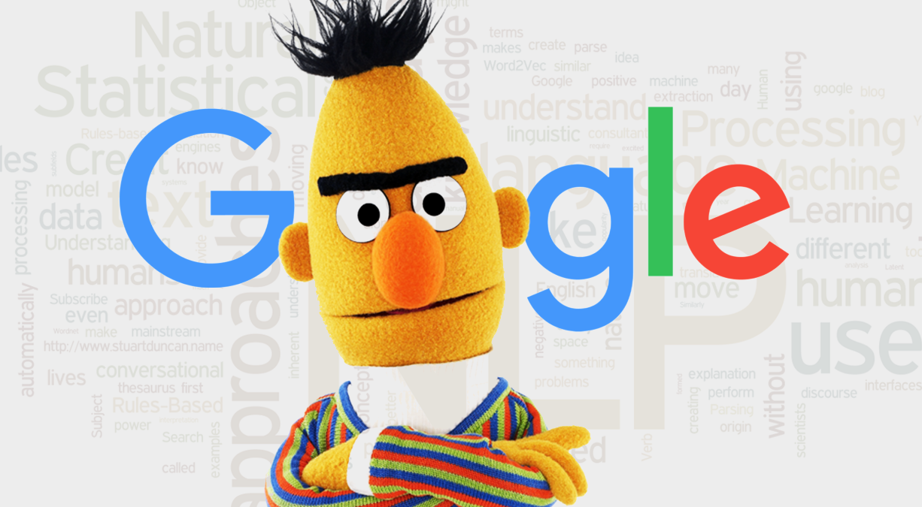
bert

Slide 12
Colab session
Navigate to https://colab.research.google.com/drive/1-1jIY9LM1axKWgtz3-95k2xgUCGJHcca?usp=sharing
Go to file > save as …. > and save the notebook with your own name/number/something unique, so you can start working on it!
Questions in the chat
For any questions, suggestions, and remarks, feel free to contact me at saskia.lensink@tno.nl

Slide 13
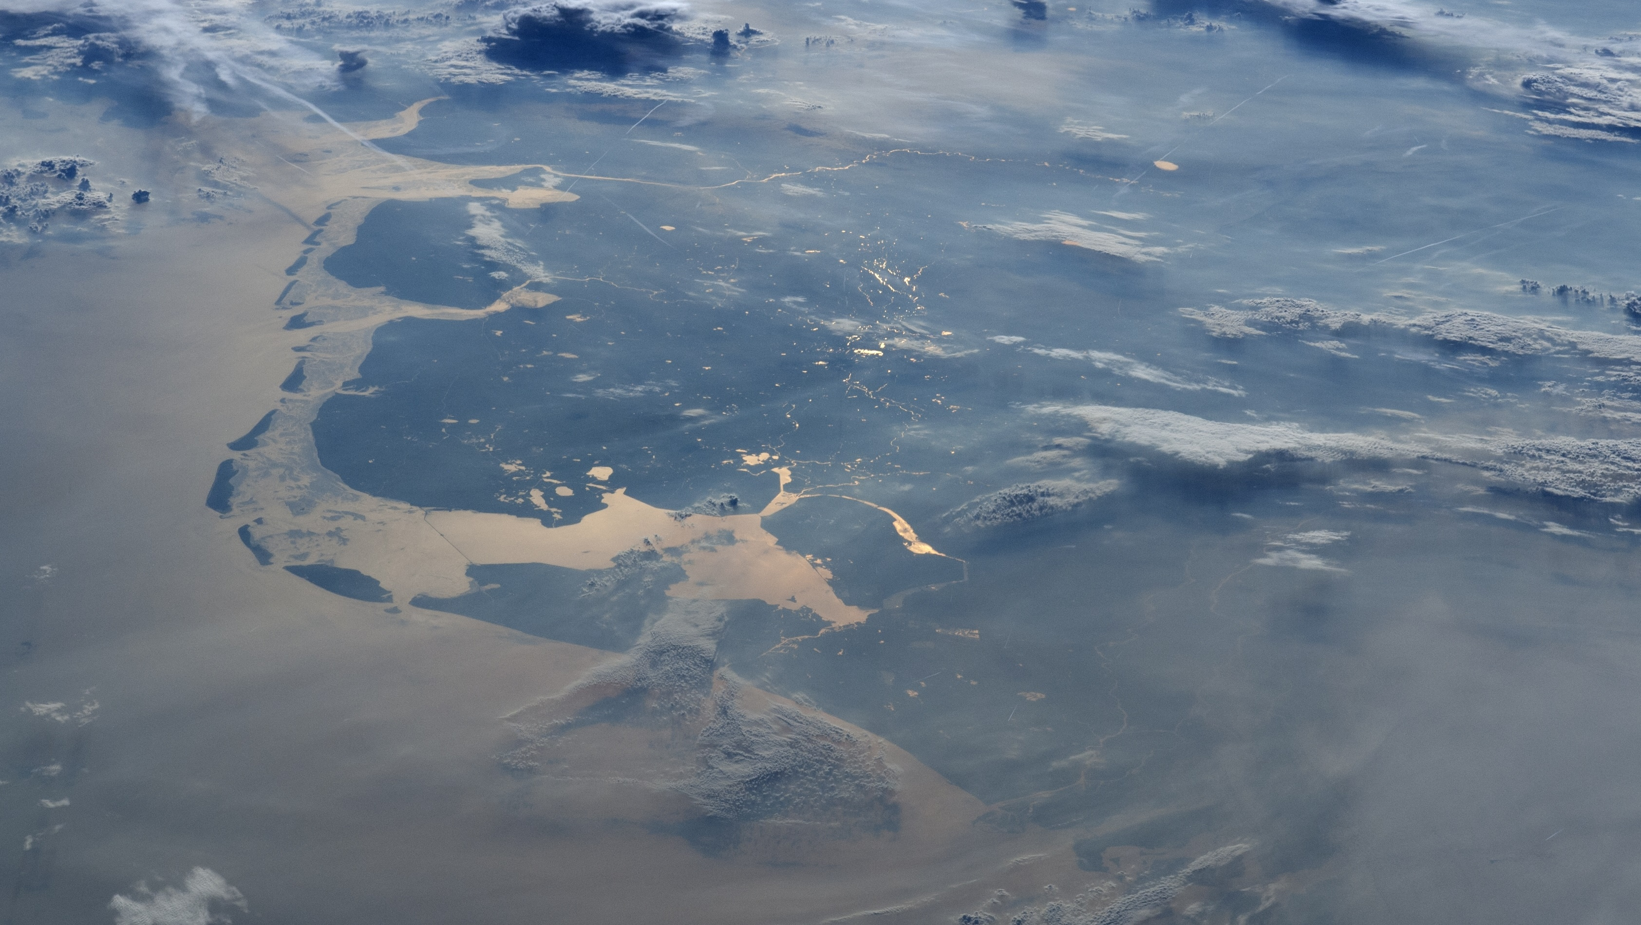
Thank you for
Your attention

